Slide 1
Significant Pasture Pests and their Control
Norm Leppla, Director
UF/IFAS Statewide IPM Program
Chris Kerr, DPM Student

Slide 2
Correct Diagnosis of Problem
Wrong cultivar
Improper site selection
Light
Temperature
Poor establishment
Drought
Poor fertility
Over grazing or cutting
Soil problems
Herbicide
Excessive wear
Compaction
Diseases
Nematodes
Insects
Animal urine

Slide 3
Insect Pests in Florida Pastures
Mole crickets
Red imported fire ants
Caterpillars
Chinch bugs
White grubs
Ground pearls

Slide 4
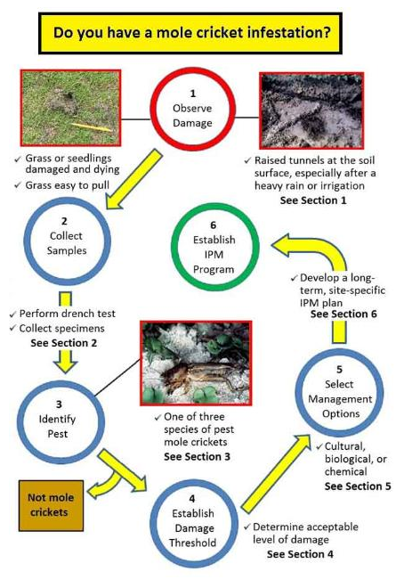
EDIS IPM-206 Mole Cricket IPM Guide for Florida
http://edis.ifas.ufl.edu/in1021
C. Kerr, N. Leppla, E. Buss & H. Frank

Slide 5
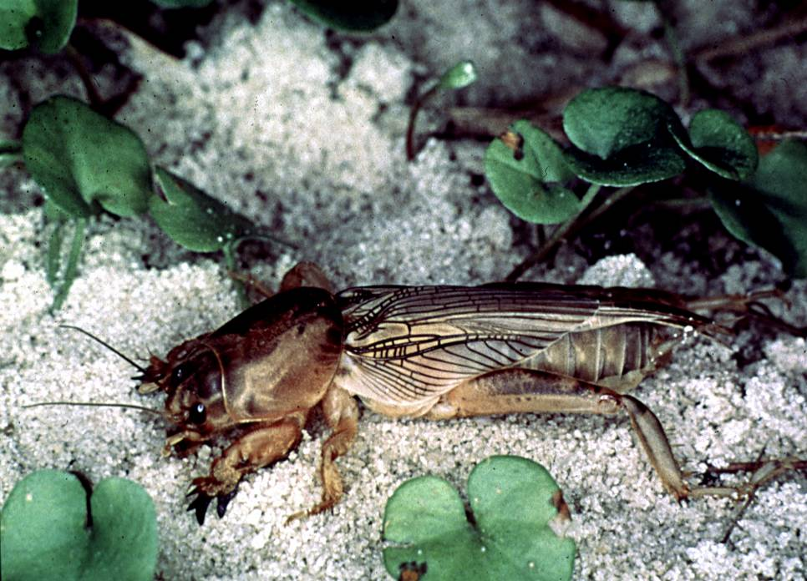
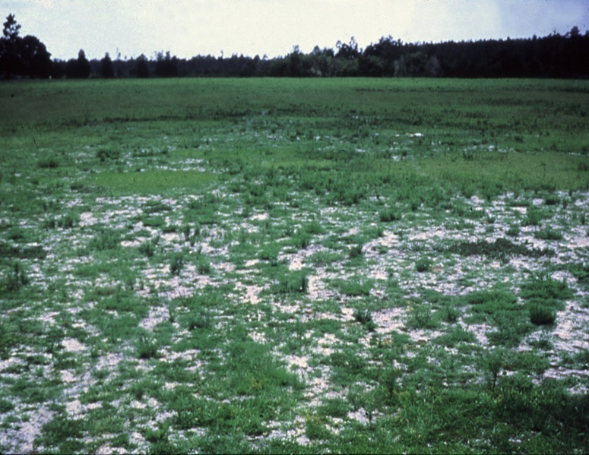
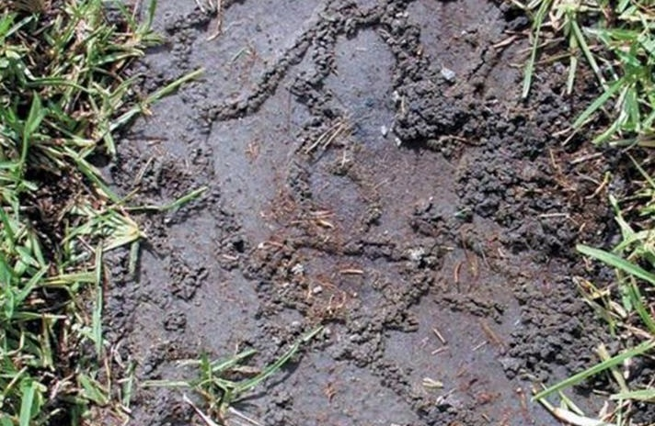
Observe Damage, Collect Specimens, Identify Pest
Shortwinged mole cricket, Neoscapteriscus abbreviatus
Southern mole cricket Neoscapteriscus borellii
Tawny mole cricket Neoscapteriscus vicinus

Slide 6
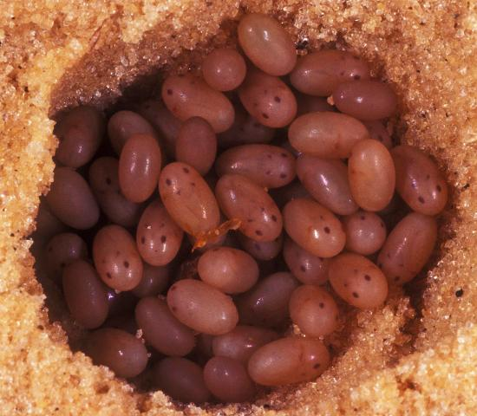
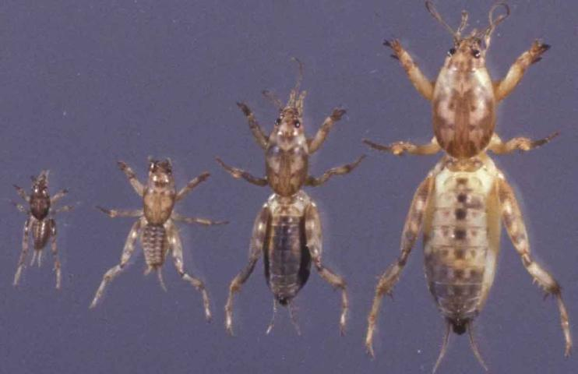
Mole Cricket Stages of Development
L. Buss, UF/IFAS
J. Castner, UF/IFAS

Slide 7
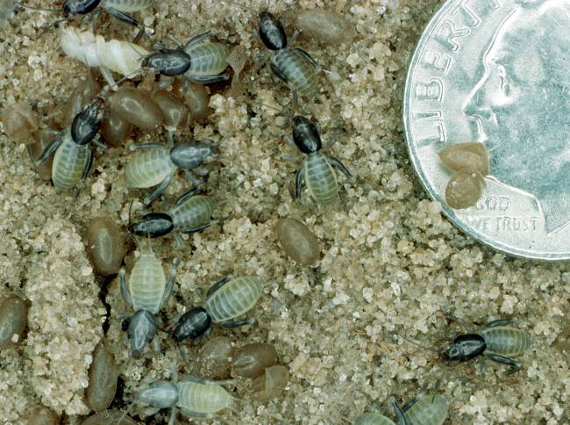
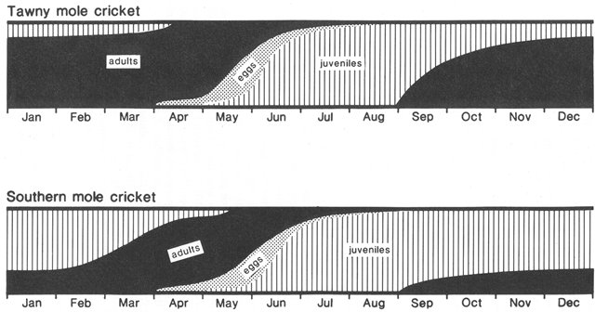
Seasonal Distribution of Mole Cricket Stages

Slide 8
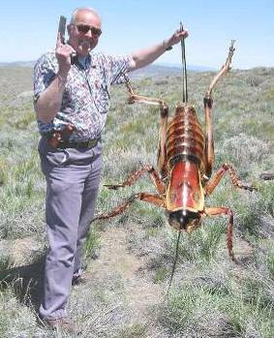
Establish Damage Threshold and Select Management Options
Cultural control
Tolerant cultivars
Soil moisture
Lighting
Tillage
Plant health
Record keeping
Biological control
Chemical control

Slide 9
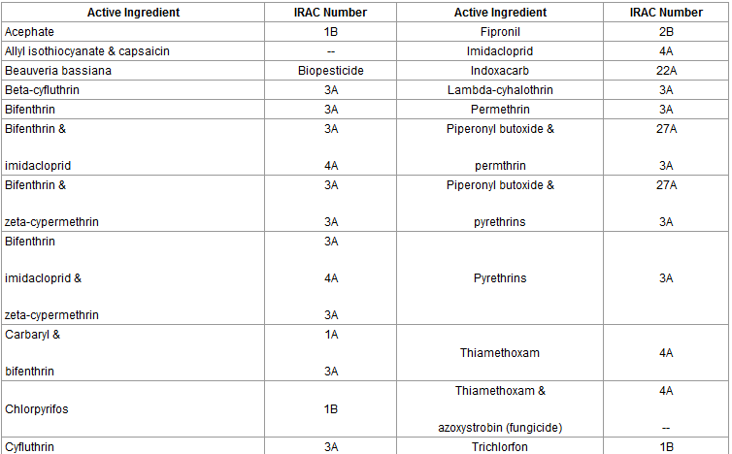
Chemical Control
Insecticide active ingredients registered
for use on mole crickets in Florida pastures
golf courses and athletic fields (effective)
National Pesticide Information Retrieval System (http://npirspublic.ceris.purdue.edu/)

Slide 10
IRAC Insecticide Classification
Acetylcholine esterase inhibitor (Carbamates, Carbaryl; Organophosphates, Malathion)
GABA-gated chloride channel antagonists (Cyclodiene organochlorines, chlordane; Phenylpyrazoles, Fipronil)
Sodium channel modulators (Pyrethroids, Pyrethrins, Bifenthrin; DDT, Methoxychlor, DDT)
Nicotinic Acetylcholine receptor agonists (Neonicotinoids, Imidacloprid; Nicotine Nicotine; Sulfoxaflor, Sulfoxaflor
Nicotinic Acetylcholine receptor allosteric activators (Spinosyns, Spinosad)
Chloride channel activators (Avermectins, Abamectin; Milbemycins)
Juvenile hormone mimics (Juvenile hormone analogues, Methoprene, Fenoxycarb, Pyriproxyfen)
Miscellaneous nonspecific (multi-site) inhibitors (Alky halides, Methyl bromide, Chloropicrin, Sulfuryl fluoride)
Selective homopteran feeding blockers (Pymetrozine, Flonicamid)
Mite growth inhibitors (Clofentezine)
Microbial disruptor of insect midgut membranes (Bacillus thuringiensis and the insecticidal proteins they produce; Bacillus sphaericus)
Inhibitors of mitochondrial ATP synthase (Diafenthiuron; Organotin miticides, Azocyclotin)
Uncouplers of oxidative phosphorylation via disruption of proton gradient (Chlorfenapyr; Sulfuramid)
Nicotinic acetylcholine receptor channel blockers (Nereistoxin analogues, Bensultap)
Inhibitors of chitin biosynthesis, type 0 (Benzoylureas, Diflubenzuron)
Inhibitors of chitin biosynthesis, type 1 (Buprofezin)
Moulting disruptor, Dipteran (Cyromazine)
Ecdysone receptor agonists (Diacylhydrazines, Tebufenozide)
Octopaminergic receptor agonists (Amitraz)
Mitochondrial complex III electron transport inhibitors (Hydramethylnon)
Mitochondrial complex I electron transport inhibitors (METI acaricides and insecticides, Fenpyroximate, Rotenone)
Voltage-dependent sodium channel blockers (Indoxacarb)
Inhibitors of acetyl CoA carboxylase - Lipid synthesis, growth regulation (Tetronic and Tetramic acid derivatives, Spirotetramat)
Mitochondrial complex IV electron transport inhibitors (Zinc phosphide, Cyanide)
Mitochondrial complex II electron transport inhibitors (Beta-ketonitrile derivatives, Cyenopyrafen)
Vacant
Vacant
Ryanodine receptor modulators (Diamides, Chlorantraniliprole)
(UN) Compounds of unknown or uncertain mode of action (Azadirachtin, Azadirachtin; Cryolite, Cryolite)

Slide 12
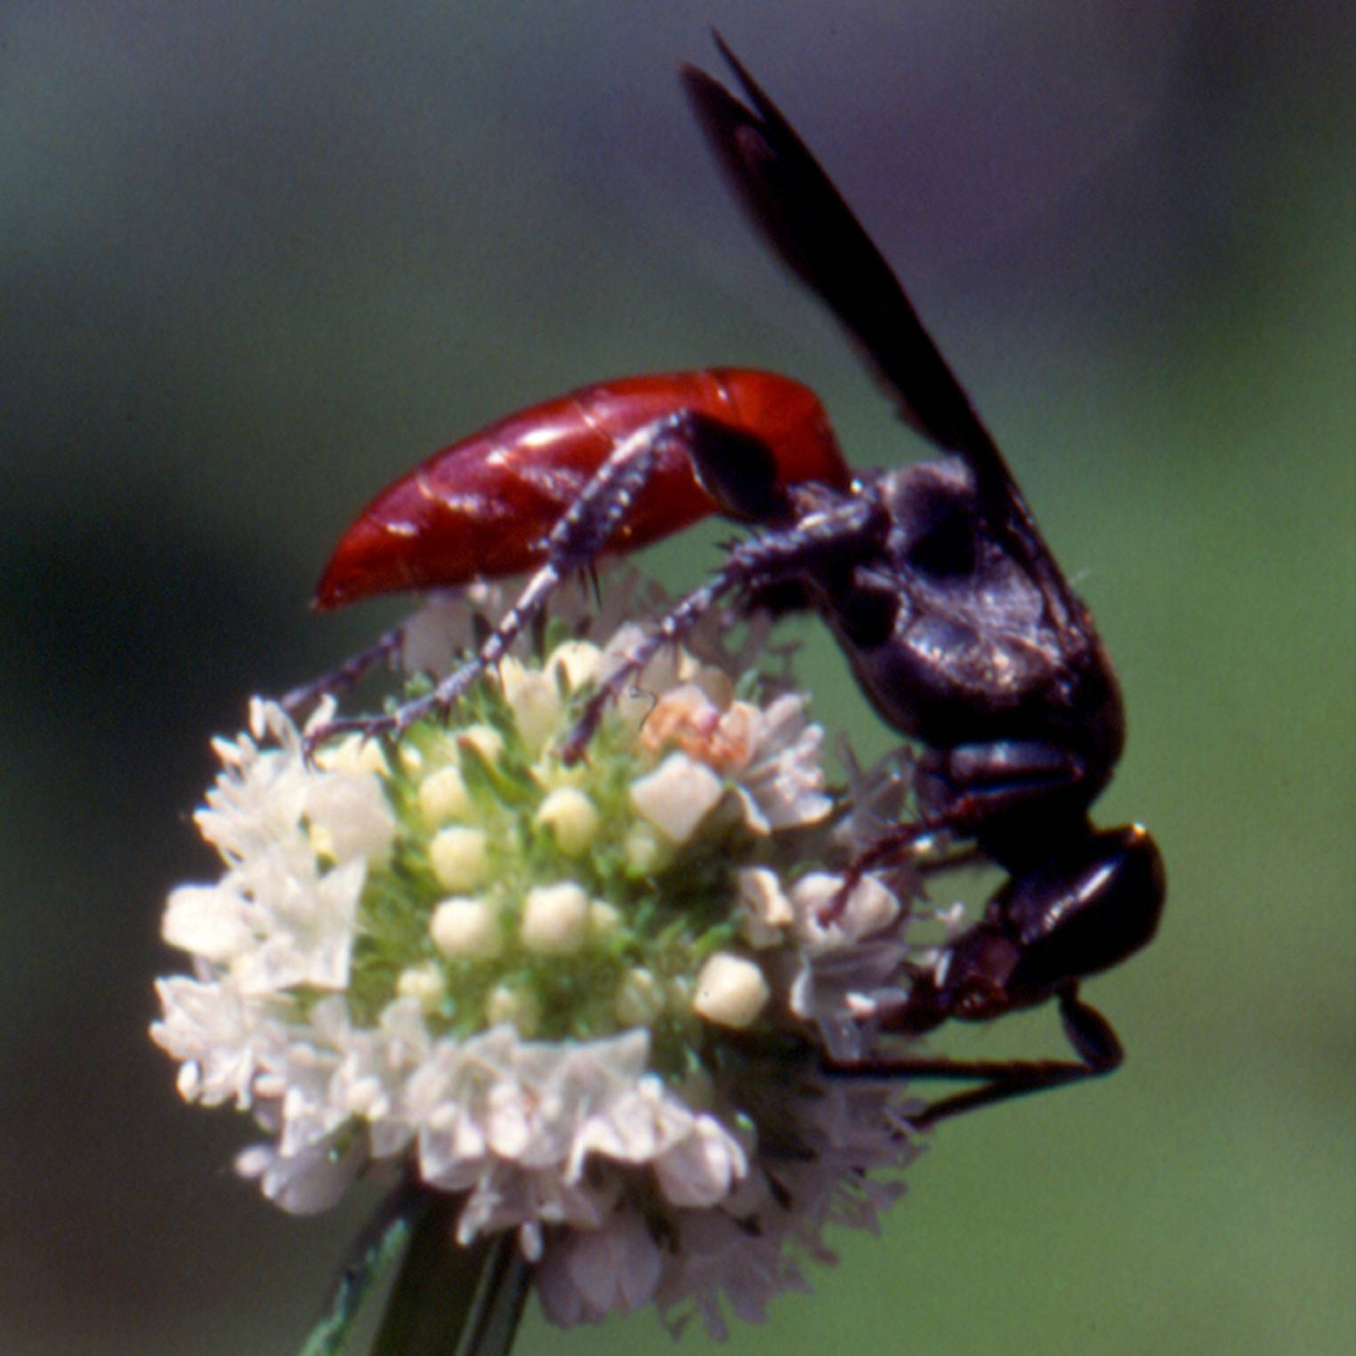
Biological Control
Mole Cricket Wasp
Larra bicolor

Slide 13
Establish IPM Program
Use tolerant grass cultivar or species
Maintain healthy grass
Perform routine soil testing- fertilizer or lime
Reduce watering during winter months
Plant nectar sources for Larra wasps
Eliminate lights during evening
Sample regularly for mole crickets
Apply insecticides if thresholds exceeded
Target and map infested areas- spot treat
Rotate insecticide classes

Slide 14
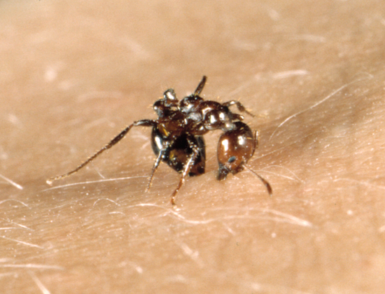
Fire Ants
Solenopsis invicta
Solenopsis richteri
Solenopsis geminata
Solenopsis xyloni
Nest in mounds, can have thousands of ants per mound, multiple queens
Omnivorous: will eat any accessible wildlife, can be beneficial
Some insect information in presentation adapted from E. A. Buss PowerPoint

Slide 15
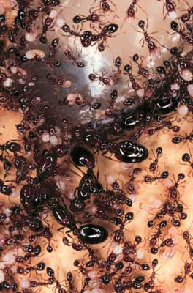
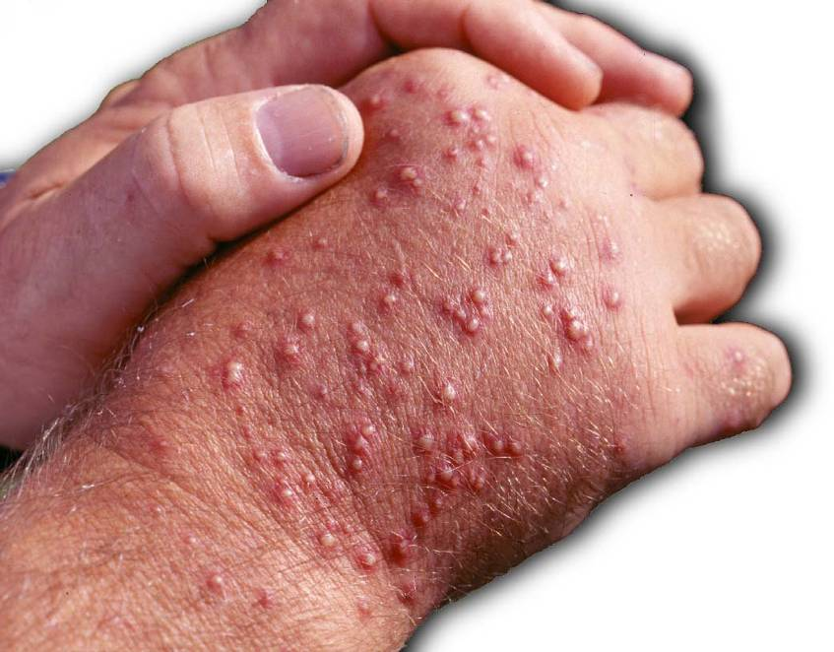
Red Imported Fire Ants

Slide 16
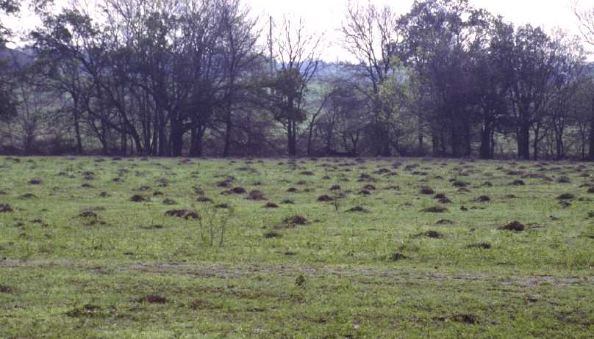
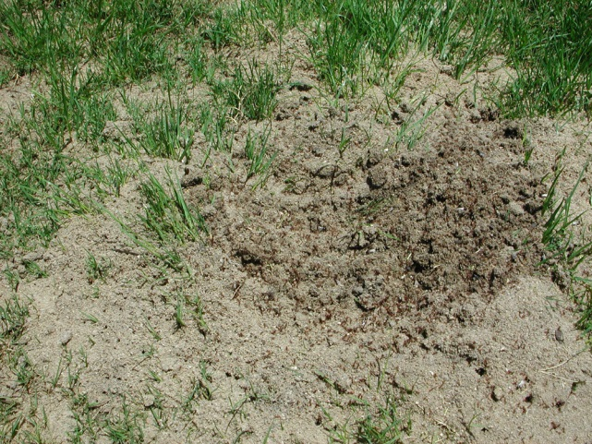
Red Imported Fire Ants

Slide 17
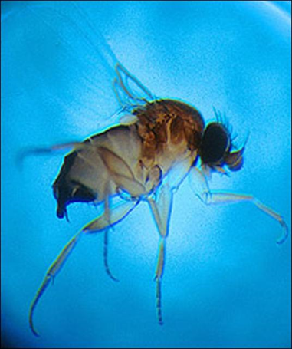
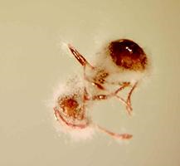
Establish Damage Threshold and Select Management Options
Chemical Control
Red Imported Fire Ants
Active Ingredient | Chemical Class | IRAC Code | Product
Beauveria bassiana | Biopesticide |  | Naturalis L
Carbaryl | Carbamate | 1A | Sevin
Pyrethrins | Pyrethroid | 3A | Pyrenone Crop Spray
Pyriproxyfen | Pyriproxyfen | 7C | Esteem Ant Bait
Spinosad | Spinosyn | 5 | Dow Agro. Justice
Spinosad | Spinosyn | 5 | Conserve Professional Fire Ant Bait
Spinosad | Spinosyn | 5 | Ferti-lome come and get it! Fire ant killer
Biological Control
Pathogens
Phorid flies

Slide 18
Chemical Control Strategies
Two Step Method-
Broadcast bait (1-2X/yr.), Hydramethylnon (Amdro) , fipronil (MaxForce® FC), indoxacarb, metaflumizone and spinosad baits; methoprene or pyriproxyfen (IGRs); Avermectins Ascend™, Award® II)
Individual mound treatment-Faster acting or repeat bait treatments (nerve toxins) or slow-acting (IGRs) baits
Initial individual mound treatment-
< 1 acre, < 20-30 mounds; dusts, dry granules, granules drenched with water after application, liquid drenches or baits.
https://edis.ifas.ufl.edu/in352
https://edis.ifas.ufl.edu/lh059

Slide 19
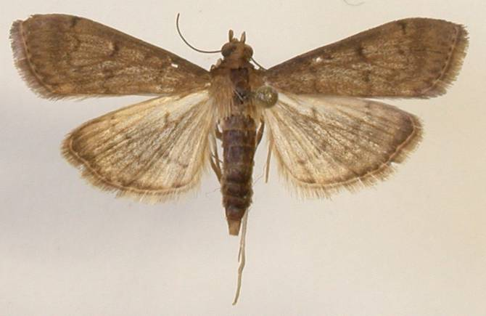
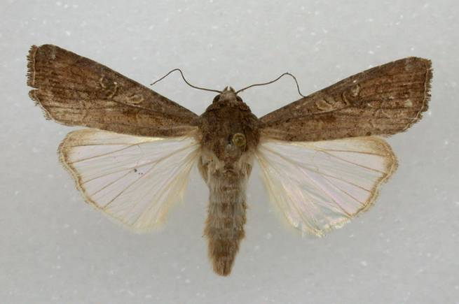
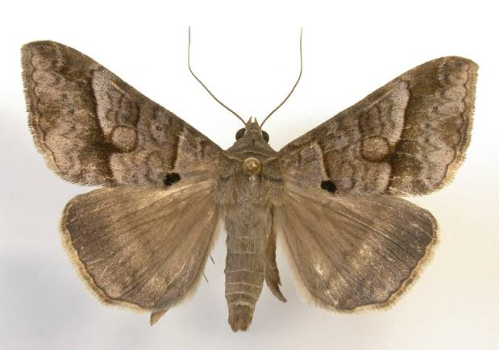
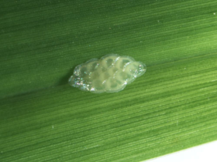
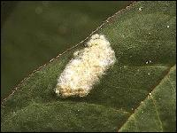
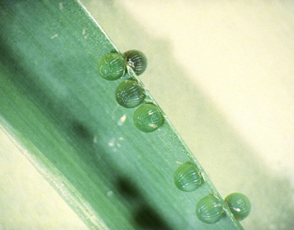
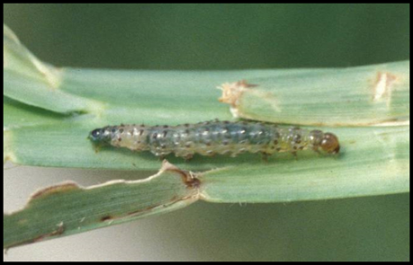
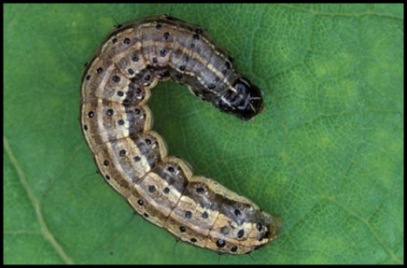
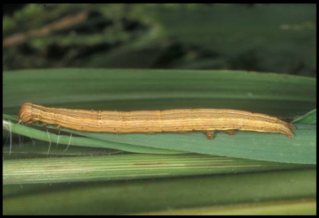
Pest Moths (Caterpillars)
Tropical sod webworm
Fall armyworm
Striped grass looper
½”
1”
1.5”
https://edis.ifas.ufl.edu/in968
http://www3.hcs.ohio-state.edu /turfwiki/index.php/File:Thb8grasslooplarva1.jpg
Moth photos- L. Buss, UF/IFAS
http://edis.ifas.ufl.edu/in255

Slide 20
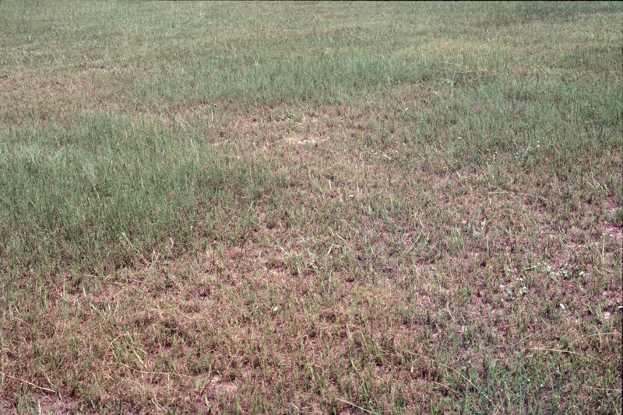
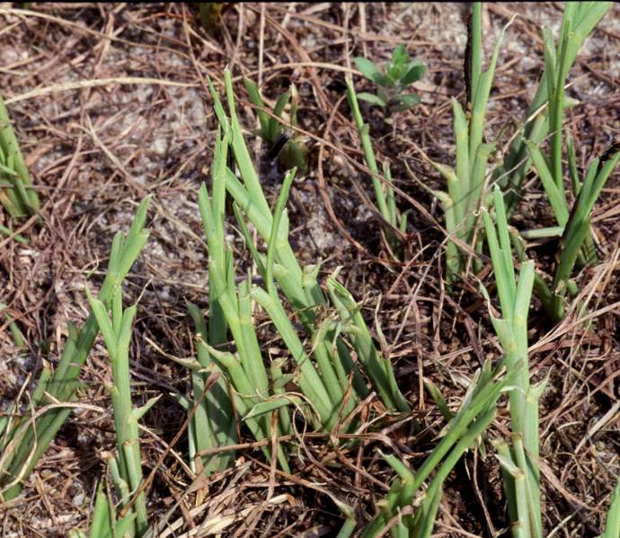
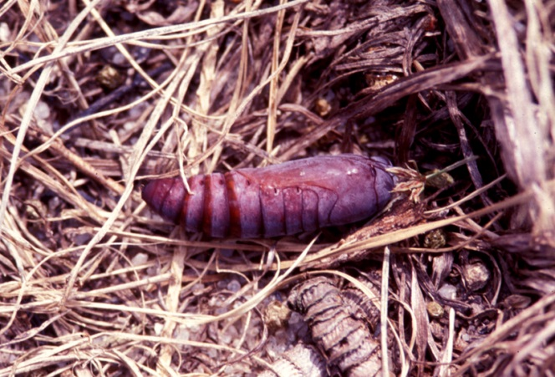
Striped Grass Looper Damage
bahiagrass polo field
Photos by L. J. Buss, UF/IFAS

Slide 21
Establish Damage Threshold and Select Management Options
Caterpillars
Active Ingredient | Chemical Class | IRAC Code | Product
Azadiractin | Azadirachtin |  | Amazin Plus, Ecozin Plus, Azatin XL
Beauveria bassiana | Biopesticide |  | Naturalis L
beta-Cyfluthrin | Pyrethroid | 3A | Baythroid XL
Bifenthrin | Pyrethroid | 3A | Brigade
Carbaryl | Carbamate | 1A | Drexel Carbaryl, Sevin
Chlorantraniliprole & lambda-Cyhalothrin | Diamide & Pyrethroid | 28 3A | Besiege Voliam Express
Diflubenzuron | Benzoylurea | 15 | Micromite, Dimilin
gamma-Cyhalothrin | Pyrethroid | 3A | Declare
lambda-Cyhalothrin | Pyrethroid | 3A | Drexel L-C, Paradigm Ravage, Willowood LAMBDA-CY 1EC, Karate, Helena Lambda, LAMCAP
 | Lamda T, Lambda-CY EC, Lambdastar, Province, Warrior II, Kendo, Grizzly, Nufarm lambda-cyhalotrin 1 EC
Malathion | Organophosphate | 1B | Drexel Malathion 5EC Malathion 57 EC
Pyrethrins | Pyrethroid | 3A | Pyrenone Crop Spray Pyganic Crop ECOPCO EC-X
 | Protection, Bug Buster-O
Spinosad | Spinosyn | 5 | Entrust
Zeta-Cypermethrin | Pyrethroid | 3A | Mustang

Slide 22
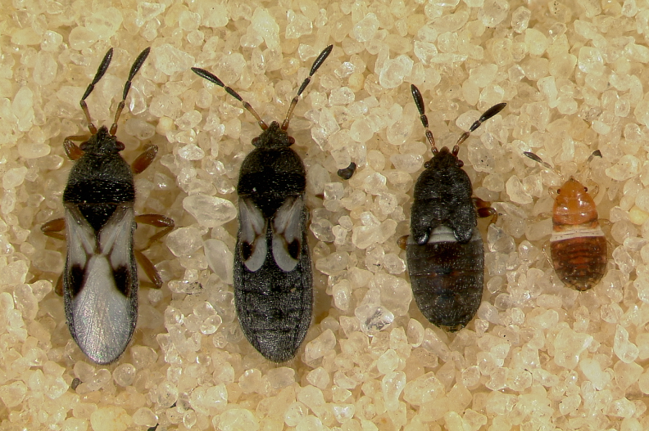
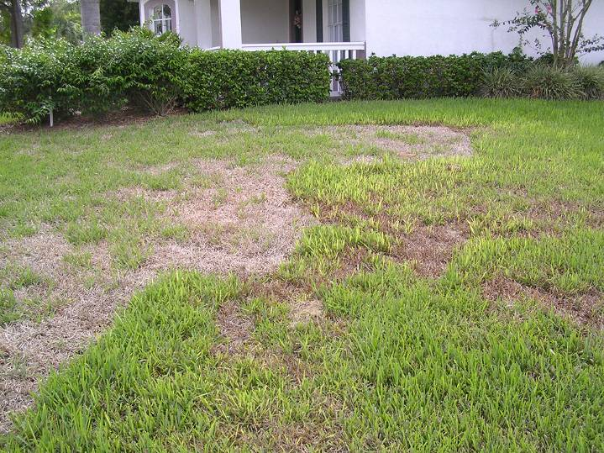
Southern Chinch Bugs
Incomplete metamorphosis: 3 life stages (egg, nymph, adult)
Eggs (300/female) laid singly in thatch, at the crown, and in leaf sheaths. Nymphs and adults also in these areas
Nymphs and adults suck fluids from turf and may inject a toxin.
Overlapping generations (4-6 weeks), 3-10/year, adult lifespan up to 2 months
L. Buss, UF/IFAS
L. Buss, UF/IFAS
https://edis.ifas.ufl.edu/in383

Slide 23
Establish Damage Threshold and Select Management Options
Chinch Bugs
Active Ingredient | Chemical Class | IRAC Code | Product
Azadiractin | Azadirachtin |  | Amazin Plus 1.2% Ecozin Plus 1.2% Azatin XL
beta-Cyfluthrin | Pyrethroid | 3A | Baythroid XL
Bifenthrin | Pyrethroid | 3A | Brigade
Carbaryl | Carbamate | 1A | Sevin, Drexel Carbaryl
Chlorantraniliprole & lambda-Cyhalothrin | Diamide & Pyrethroid | 28 3A | Besiege Insecticide
gamma-Cyhalothrin | Pyrethroid | 3A | Declare Insecticide Karate Insecticide Helena Lambda LAMCAP Lamda T Province Insecticide Warrior II
 | Grizzly, Lambda-CY EC, Lambdastar, Nufarm lambda-cyhalotrin 1 EC, Drexel L-C Insecticide Paradigm, Kendo, Ravage Willowood LAMBDA-CY
Pyrethrins | Pyrethroid | 3A | Pyrenone Crop Spray Pyganic, ECOPCO EC-X
Zeta-Cypermethrin | Pyrethroid | 3A | Mustang
Egg parasitoid, big eyed bugs, minute pirate bugs, nabids, earwigs, spiders, ants- Avoid excessive fertilization, dethatch turf

Slide 24
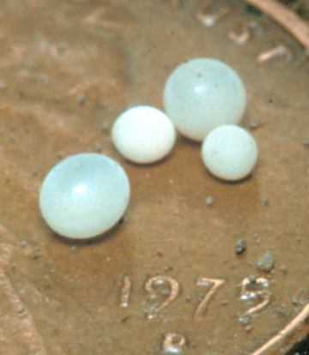
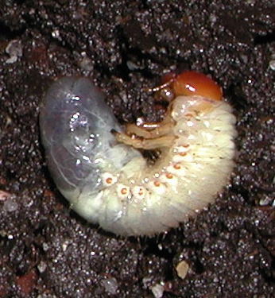
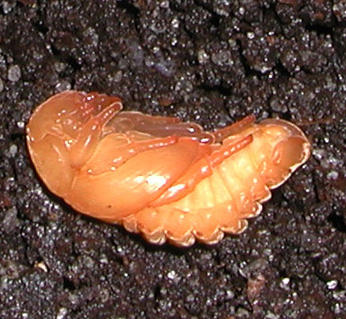
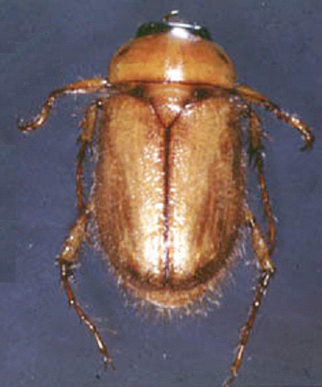
Scarab Beetles (Grubs)
Masked Chafers 6 species in Florida
May/June Beetles 54 species in Florida
Grubs feed on all warm-season grasses
Adults don’t eat
1-2 generations/year in Florida
3-segmented, clubbed antennae
Larvae molt 3 times (have 3 instars)
EGG
LARVA
PUPA
ADULT

Slide 25
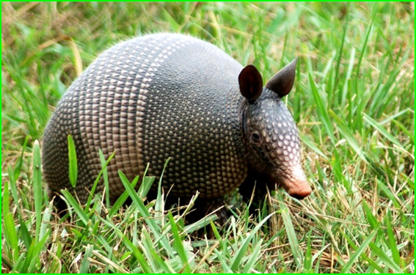
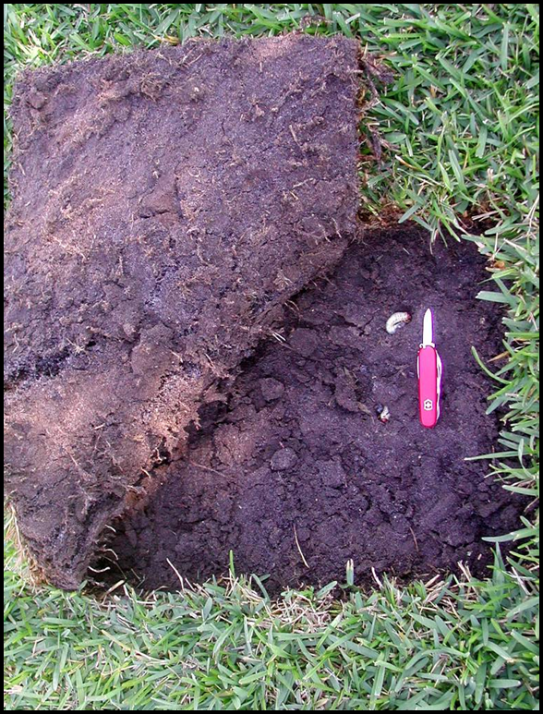
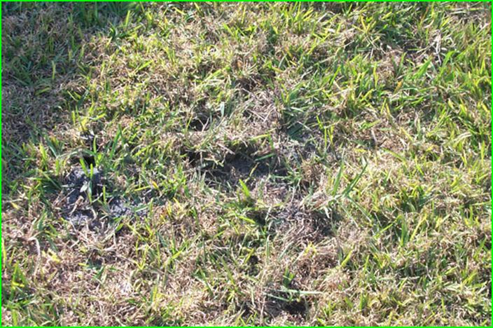
Grub Damage
Insidious Grub Detector and Grass Destroyer

Slide 26
Establish Damage Threshold and Select Management Options
Chemical Control
Insecticides registered for turf- imidacloprid (Merit®, Season-Long Grub Control®), thiamethoxam (Meridian®), halofenozide (Mach2®, Ortho Grub-B-Gon®, Grub-Ex®), clothianidin (Arena®), chlorantran-iliprole (Acelepryn®), or a pyrethroid/neonicotinoid mix (Allectus®, Aloft®). http://edis.ifas.ufl.edu/lh037
Biological Control
Nematodes
Pathogens

Slide 27
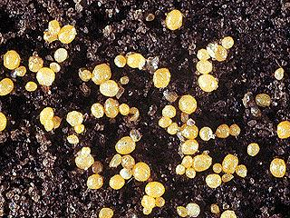
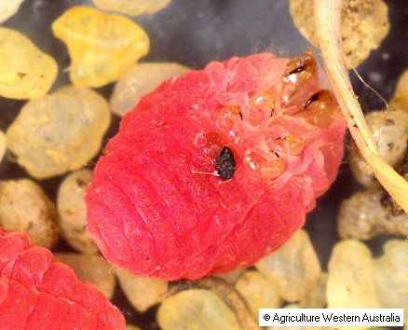
Ground Pearls (Scales)
Prefer bermudagrass and centipedegrass
https://edis.ifas.ufl.edu/lh073

Slide 28
For more information or a copy of this presentation please visit:
http://ipm.ifas.ufl.edu

